Slide 1
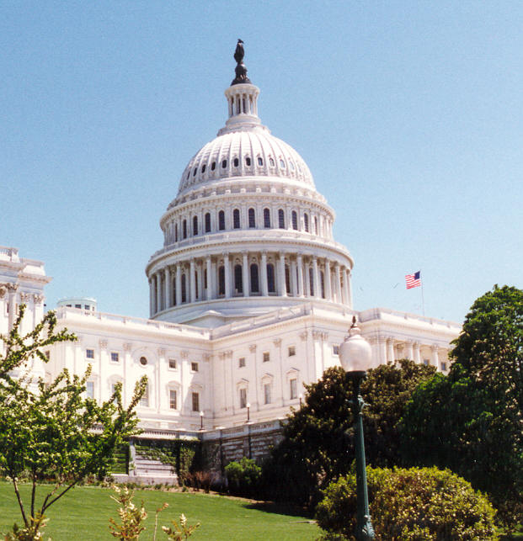

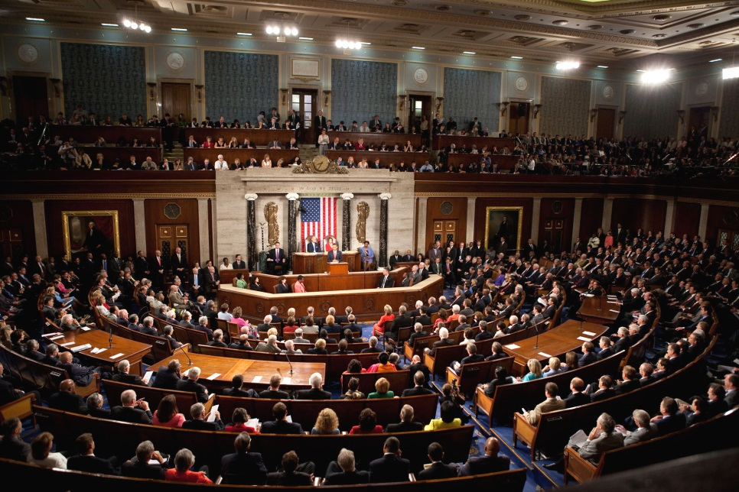


Congress and Powers of Congress
Chapters 10 and 11

Slide 2
The National Legislature
Article 1, Section 1
“All legislative Powers herein granted shall be vested in a Congress of the United States, which shall consist of a Senate and House of Representatives.”

Slide 3
Bicameral Congress – Two House Legislature
Historical
  British Parliament – Two House Legislature
  House of lords and House of commons
  Most Colonies had two houses
Practical
  Two House Legislature
    House of Representative and a Senate
Theoretical
  With a two house legislature, it allows each house to keep a check on the other.

Slide 4
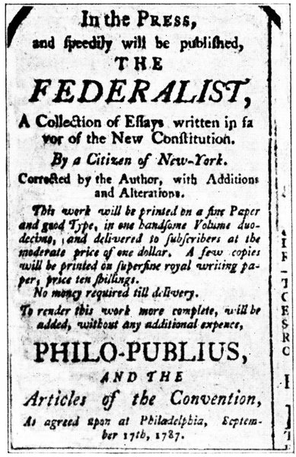
Federalist 51
“In republican government, the legislative authority necessarily predominates. The remedy for this inconveniency is to divide the legislature into different branches. . .”

Slide 5
Terms and Sessions
A term of Congress last for two year.
20th Amendment, Section 2
  “The Congress shall assemble at least once in every year, and such meeting shall begin at noon on the 3d day of January, unless they shall by law appoint a different day.”
    Noon of the 3rd day of January of every odd numbered year.

Slide 6
Terms and Sessions
A session of Congress is that period of time during which, each year, Congress assembles and conducts business.
Adjourns – suspend until the next session
  Neither house may adjourn without the consent of the other.
    Article 1, Section 5, Clause 4
Prorogue – the President’s Power to end a session of Congress
  Article 2, Sec. 3

Slide 7
Terms and Sessions
Special Session
  A meeting to deal with some emergency situation
  Only the President may call a special session
  The fact that Congress is in session almost year round reduces the likelihood of a special session.

Slide 8
Review
How long does a term last?
How does a special session differ from a regular session?
When does Congress adjourn?
Who has the power to prorogue?

Slide 9
The House of Representatives
435 Seats
Seats shall be apportioned, or distributed among the states based on population.
Each state is guaranteed at least one seat.
A Representative serves a two year term.

Slide 10
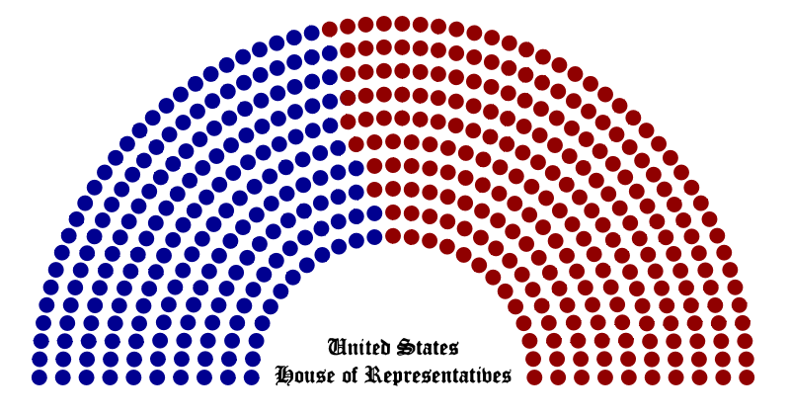
The House of Representatives

Slide 11
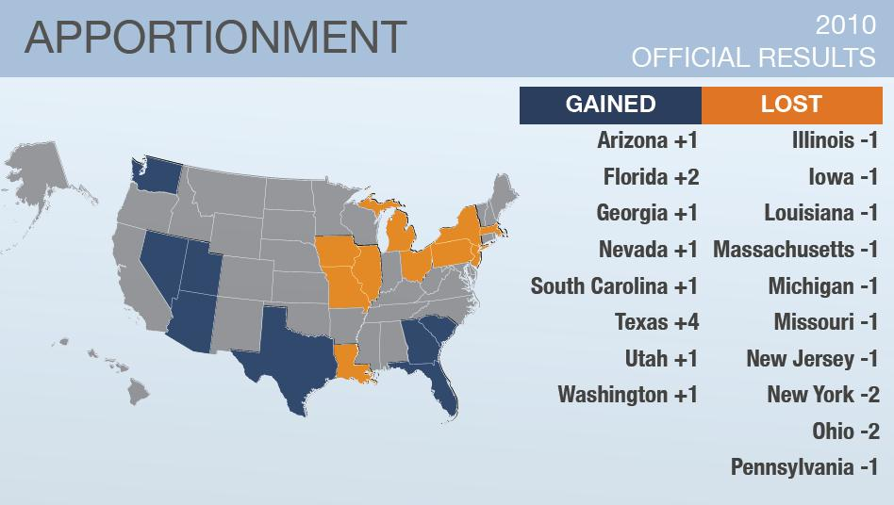
Reapportionment
Reapportionment is the redistribution of seat in the House after each decennial census.

Slide 12
Reapportionment
Reapportionment
  1st Congress was 65
  Raised to 106 in 1792
  A Growing Nation
    Raised to 142 in 1800
    Raised to 186 in 1810
    435 by 1912 (Arizona and New Mexico were added)
    No reapportionment in 1920

Slide 13
The Reapportionment Act of 1929
It set the “permanent” size of the House to 435 members.
Following a census, the Census bureau has to determine how many seats each state should have.
The President must then send this plan to Congress.
If the House and Senate approve, it becomes effective.

Slide 14
http://2010.census.gov/2010census/data/
Who gained seats (sunbelt) from reapportionment and who lost seats (rustbelt)

Slide 15
Congressional Elections
Article 1, Section 1, Clause 4
  “The Times, Places and Manner of holding Elections for Senators and Representatives, shall be prescribed in each State by the Legislature thereof; but the Congress may at any time by Law make or alter such Regulations, except as to the Places of chusing Senators”
Date
  Congressional Elections are held on the Tuesday following the first Monday in November on each even numbered years

Slide 16

Congressional Elections
Off-year elections – elections held in nonpresidential years
  Most of the time, the controlling party loses seats in the Congress during this election.

Slide 17
Districts
Representative are elected from single-member districts or general ticket system.
Single-member district – voters elect a representative from their own district
General ticket system – voters choose representatives at-large, that is, they elect from a state as a whole
  Ended in 1842

Slide 18
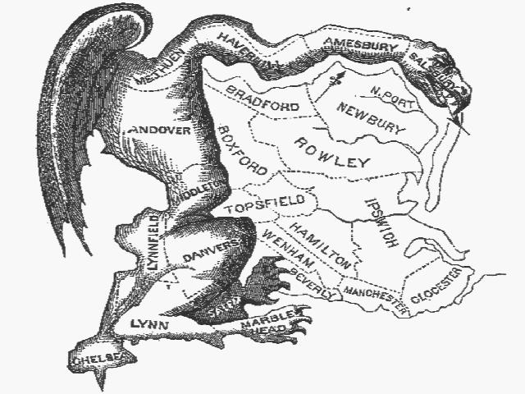
Gerrymandering
Gerrymandering – districts have been drawn to the advantage of the political party that controls the state legislature.

Slide 19
Gerrymandering
  Gerrymandering
    Can concentrate opposition in one or a few districts.
    Spread the opposition to make all districts open.
    Aims to create “safe” districts.

Slide 20

Gerrymandering

Slide 21
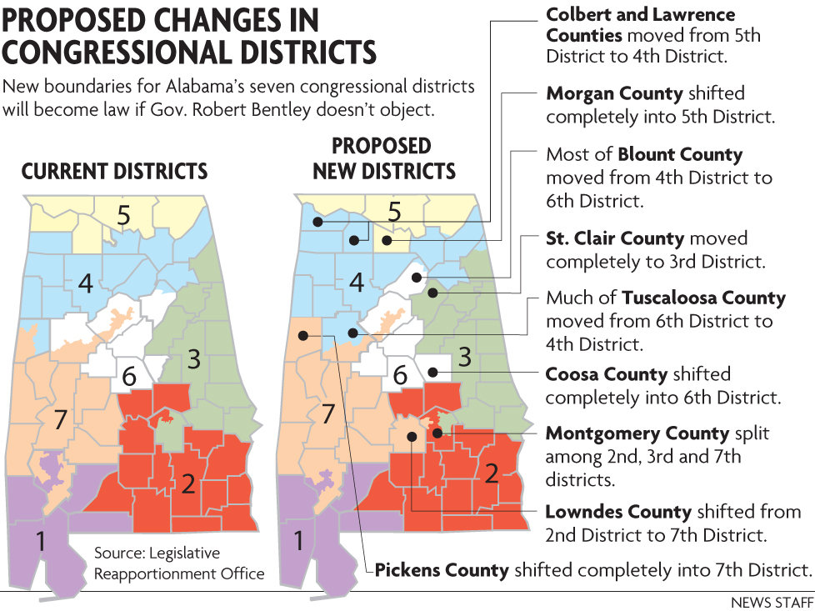
Congressional District in Alabama

Slide 22
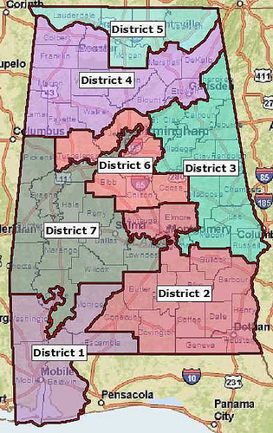
Alabama Congressional Districts

Slide 23
Congressional District in Alabama
How many congressional districts are in Alabama?
Which district do you live in?
Who is your representative?
What term means that congressional districts have been drawn to favor a political faction?
Who draws congressional districts?
Who controls the state legislature in Alabama?

Slide 24
The Courts v. Gerrymandering
Wesberry v. Sanders (1964)
    Said that the population Established principle of equal representation.
    Later: One person---one vote principle.
    Race cannot be the primary determinant in districting, but can be one factor.
Gomillion v. Lightfoot (1960)
  Case that said that gerrymandering based on race is a violation of the 15th amendment

Slide 25
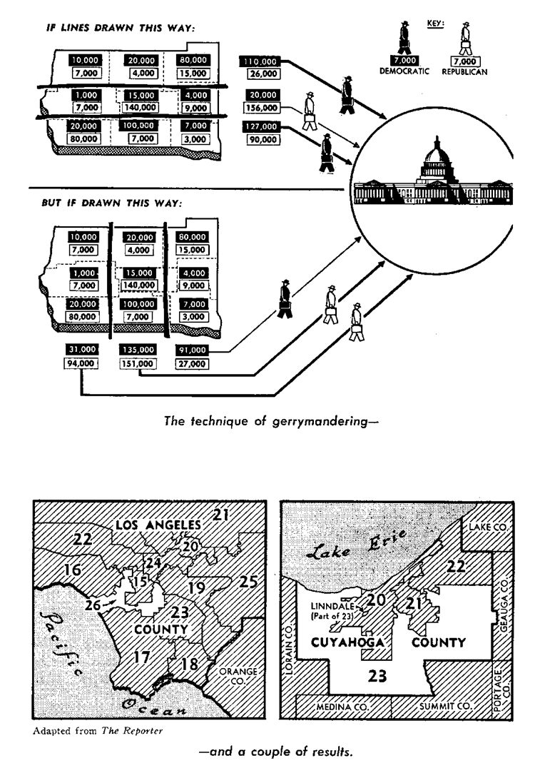

Slide 26
The House
Larger Body (435 members)
Short Term (2 Years)
U.S. Citizen for 7 Years
Smaller Constitutes
Younger Membership (25 years old)
Less Prestige
Lower Visibility in the Media
Strict Rules, Limited Debate
Most of the work is done in committees
No Powers over treaties and Presidential appointments
All “Money” bills begins in the House

Slide 27
The House
A custom for representatives is that he or she must live in the district they represent.
A member can be expelled for disorderly conduct.
Powell v. McCormack (1969)
  The Supreme Court ruled that the House could not exclude a member-elect who meets the constitutional requirements of age, citizenship, and residence.

Slide 28
Review
How are the seats in the House apportioned?
When will the next two off year election occur?
Explain the difference between a single-member district seat and an at-large seat.
Why do politicians gerrymander districts?

Slide 29
The Senate
Smaller body (100 Members)
Longer Terms (6 years)
U.S. Citizen for 9 years
Larger Constituencies
Older Membership (30 years old)
More Prestige
Higher Visibility
Flexible Rules, nearly unlimited debate
Work is split between committee and the floor
Approves or rejects treaties and presidential appointments

Slide 30

The Senate
The Senate Historically
    1789—22 members
    1791—26 members
    “Dispassionate.”
    Represent entire states.
50 States x 2 senators per state = 100 senators

Slide 31
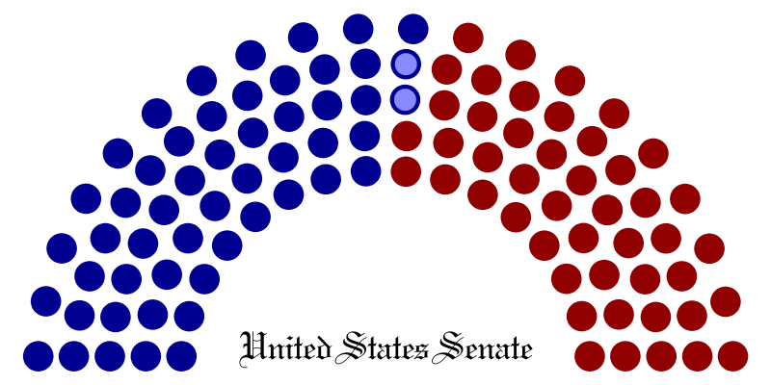
The Senate

Slide 32
The Size of the Senate
The Framers hoped that the smaller size of the Senate would be a more enlightened and responsibility than the House.
James Madison saw the provisions for the smaller Senate as “a necessary fence” against the “fickleness and passion” of the House.

Slide 33
Election to the Senate
Originally, Senators were elected by the state legislatures until 1913.
The 17th Amendment changed the election of senators by state legislatures to direct election of senators.

Slide 34
Term of a Senator
6 Year term – No Term Limits
  Longer terms gives Senators more job security
Continuous Body
  All the seats are not up for election at the same time
    Terms are staggered 33 or 34 each 2 year election.
Constituencies
  The people and interest the senators represents

Slide 35
Review
Why is the Senate called a continuous body?
How does the senators view of his constituency differ from a representatives view of their constituency?
Why do Senators receive more public attention than Representative?

Slide 36
Personal and Political Backgrounds
  Not representative
  Median age of House is 55, Senate 60
  Mostly male. 68 women in House, 14 women in the Senate.
42 African Americans, 24 Hispanics, 5 Asians, and 1 Native American in the House
  1 African American, 2 Hispanics, 1 Asian, 1 Hawaiian sit in Senate.

Slide 37
Personal and Political Backgrounds
  Most are married and average 2 children.
  60% are Protestant, 30% Catholic, 6% Jewish.
  1/3 of House and 1/2 of Senate are lawyers
  Nearly all have a college degree and many advanced degrees.

Slide 38
Personal and Political Backgrounds
  Most have political experience
    Senators average in second term
    House members 4 terms
    Former governors
    Cabinet seats

Slide 39
The Job
  Roles of Congress
    Legislators
    Representatives of constituents
    Committee members
    Servants of constituents
    Politicians

Slide 40
The Job
  Representation of the People
    Trustee
      Lawmaker who votes based on his or her independent judgment and conscience, not the views of his or her constituents
    Partisans
      Lawmaker who owes his/her first allegiance to his/her political party and votes according to party lines
    Politicos
      Lawmaker who attempts to balance the basic elements of the trustee, delegate, and partisan roles

Slide 41
The Job
Committee Members
  In every session of Congress, proposed laws(bills) are referred to committees to determine which bill should be allowed on the floor for consideration.
  Oversight Function
    Process by which Congress, through its committees, check to see that various agencies in the executive branch are working effectively and acting in line with the politics that Congress has set by law.
Servants

Slide 42
Compensation
Salary
Compensation
  Salary
    $174,000
    Speaker=$223,400
    Senate president pro tem=$193,400
  Non-salary Compensation
    Fringe benefits
    Travel
    Franking privilege
      Send mail postage free
    Free printing

Slide 43
Compensation
The Politics of Pay
  Controversial
  Membership Privileges
    Legislative Immunity
    To protect free speech

Slide 44
Review
What does a trustee value most when deciding how to vote on a bill?
What does a partisan value most when deciding how to vote on a bill?
How does the franking privilege help members of Congress?
What is the oversight function?

Slide 45
Congress and Powers of Congress
Chapters 10 and 11

Slide 46
The Scope of Congressional Powers
Congress has broad power, but limited by principles of federalism and limited government.
Congress’ has three types of powers
  Expressed powers—those powers given in so many words
  Implied powers—those things implicit from the Necessary and Proper clause
  Inherent powers – powers given just because it’s the national government

Slide 47
What Congress Can Not Do
Congress is denied power because of what the Constitution says, what it does not say, and because of the federal system itself.
Congress Can Not
  Create a public school system
  Require people to attend church

Slide 48
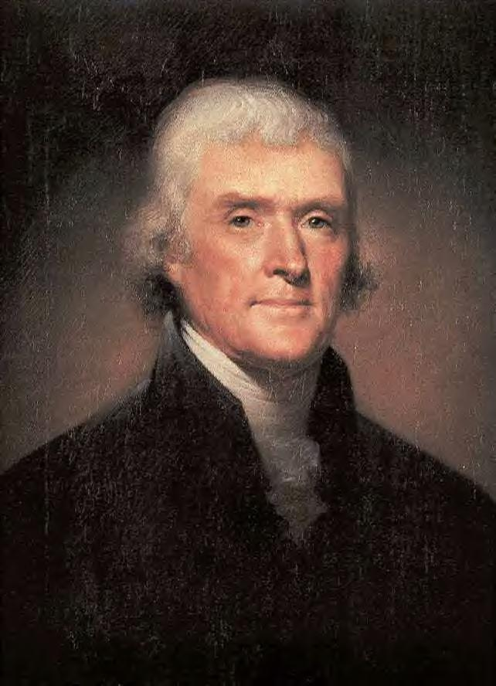
Strict v. Liberal Construction
Always a debate about how broadly implied powers should be interpreted.
Strict Construction:
  Thomas Jefferson and traditional conservatives.
  “Necessary” means essential or critical.
  Err on the side of the states if a close call.
  Too much power in the hands of national government is a bad thing
  “that government is best when it governs least”

Slide 49
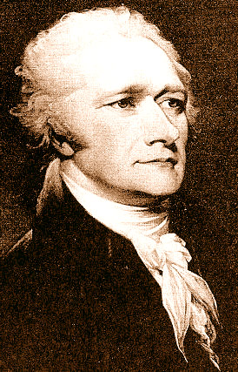
Strict v. Liberal Construction
Liberal Construction
  Hamilton and other Federalists.
  Wanted broad interpretation of the necessary and proper clause so the government could energetically handle national problems.
  Liberal construction has largely won out, although the debate continues today.
  Federal government has more power today than anyone could have foreseen in 1787.

Slide 50
Reasons for Growth of National Government
Wars and other national emergencies have led the government to try for more power to deal with them
Advances in transportation and communication have made it more practical for federal government to control more issues
People have demanded more and more from federal government
Supreme Court has consistently interpreted the Necessary and Proper Clause broadly.

Slide 51
Review
Explain the difference between expressed, implied and inherent powers.
Compare the views of a strict and liberal constructionist.
Give three examples that Congress can enact under the Constitution and three that Congress can not enact.

Slide 52
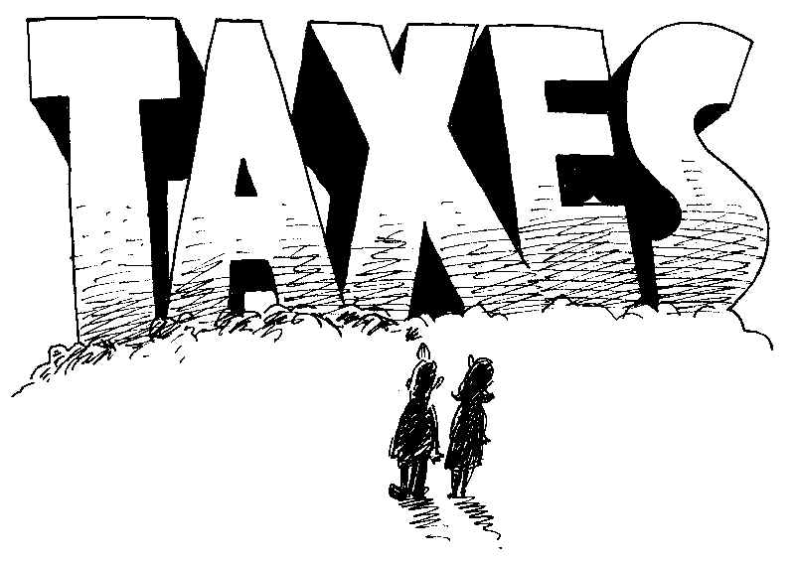
The Expressed Powers
Power to Tax
Art. I, Section 8, Clause 1
Income Tax not authorized until the 16th Amendment
Other taxes: Tariffs, excise taxes
Purposes of taxes
  To raise money. Primary purpose of taxes
  To protect domestic industry—tariffs
  To discourage behavior—taxes on cigarettes and alcohol

Slide 53
Types of Taxes
Direct Tax- taxes that must be paid by the person on whom the tax is imposed
  Tax on ownership of land
  Income tax
Indirect Tax- taxes paid first by one person, but is then passed on to another
  Federal taxes on cigarettes

Slide 54

Limits on the Power to Tax
Four specific limits in Constitution.
  May only tax for public purposes
  Can’t tax exports. Tariffs only on imports
  Direct taxes must be apportioned based on population
  Indirect taxes must be levied at the same rate throughout the country
Taxes can’t violate the Bill of Rights
  Taxes can’t discriminate or infringe speech

Slide 55
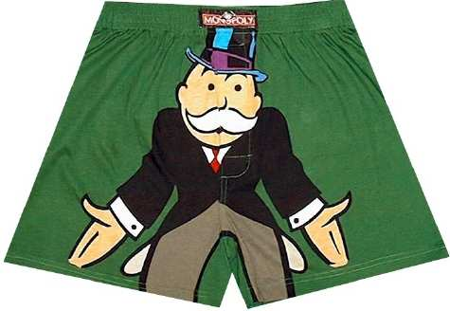
Power to Borrow
Congress has the power to borrow without limit.
Federal government has historically borrowed money to pay the yearly budget.
Deficit Financing.
  Spending more than it takes in each year
  Budget Deficit v. National Debt.
  Current National Debt
1969-1998 ran a deficit every year. 1999-2001 surplus
Post 9-11 we have run huge deficits again. Reasons:
  Bush Tax Cuts with Gov’t expansion
  Economic down-turn cut revenue
  Cost of Iraq War

Slide 56

The National Debt

Slide 57
Commerce Power
The power of Congress to regulate interstate and foreign trade.
Gibbons v. Ogden (1824) “Commerce” should be read broadly.
  Defined to include all commercial activities and all rules that impact commercial activities.
  Result was that almost everything that involves business in any way can be regulated by Congress under the Commerce Clause
Commerce clause is now the basis for many federal laws that only indirectly deal with buying and selling.
Many of the implied powers are based on the commerce clause

Slide 58
Four restrictions on commerce power
Congress cannot Tax Exports
Congress cannot Favor the ports of one State over those of any other in the regulation of trade
Congress cannot require that “vessels bound to or from, one state, be obliged to enter, clear or pay Duties in another
Congress could not interfere with the slave trade until the year 1808.

Slide 59
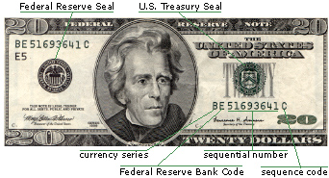
The Currency Power
Power to coin money
Until 1964 Government minted only actual metal coins.
Legal Tender—Paper Money that all merchants and others must accept for the payment of debts.
First Legal Tender not issued until 1862.

Slide 60
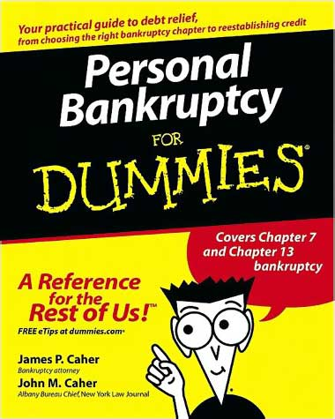
Bankruptcy
Congress has the power to establish uniform laws on bankruptcies.
All bankruptcy laws are federal laws.
  States have concurrent power, but no room for state laws.
  All bankruptcy proceedings are in federal courts.
“Bankrupt”
“Bankruptcy”
  the legal proceeding in which a bankrupt persons assets are distributed to those that they owe money too
Liquidation v. Reorganization

Slide 61
Review
Explain direct and indirect taxes and give an example of each.
Give three factors that brought on deficient financing at the Federal level.
Give three examples of how Congress uses its commerce power.
What problems led the Framers to give Congress the Power to coin money and make it legal tender.

Slide 62
Other Expressed Powers
Foreign Relations and War Powers
The president has the primary responsibility, but the Congress is also involved.
Foreign Relations Powers
  Generally effects foreign relations through powers to regulate commerce, approve treaties and regulate immigration.
War Powers. Eight of the expressed powers given to Congress in Article 1, Sect. 8 deal with war and national defense.
  Powers are largely shared with President
  Only Congress may declare war
  Raise and support armies
  provide for a navy
  rules for governing the military

Slide 63
Additional Powers of Congress
Naturalization
  Process by which citizens of one country become citizens of another.
  Article I, Section 8, Clause 4
The Postal Power
  Article I, Section 8, Clause I

Slide 64

Copyrights and Patents
Copyright is the exclusive right of an author to reproduce, publish and sell his or her creative work and derivations of it.
  Right may be assigned
  Are registered by the Copyright Office in the Library of Congress. Not required to be registered
  Good for life of author plus 70 years.
Patent grants a person the sole right to use manufacture or sell an invention.
  Patents last for 20 years

Slide 65
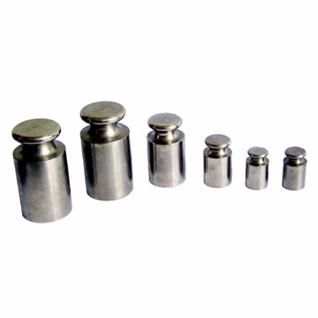
Weights and Measures
Congress has the power to fix the standards of weights and measures throughout the United States.
  1838 Congress set the English system as the legal standard.
  National Institute of Standards and Technology in the Commerce Department keeps the original standards for the United States.
  These are the official weights and measures against which all others are calibrated.

Slide 66
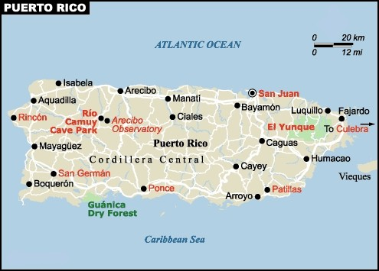
Power Over Territories and Other Areas
Congress has the power to acquire, manage and dispose of federal territory.
  Includes D.C., Puerto Rico, Guam and the Virgin Islands.
  Also federal property such as military bases, post offices, federal parts, etc.
  Feds may acquire property by purchase or gift. It may also do so through the exercise of eminent domain
    Take private property for public good
  Congress also has the power to obtain lands from foreign states and to admit new states.

Slide 67
Review
Explain how Congress and the President share power in the fields of foreign relations and defense.
Where does Congress get its power to regulate naturalization.
How does a copyright differ from a patent?

Slide 68
The Implied Powers
Necessary and Proper Clause is the basis for most implied powers. Art. I, Sect. 8, Clause 18. Power
Often called the elastic clause because of the broad way in which it has been interpreted by the Supreme Court.
Battle Over Implied Powers—McCulloch v. Maryland

Slide 69
McCulloch v. Maryland
Battle over the Second Bank of the United States.
Maryland taxed the bank
The Supreme Court ruled this unconstitutional
Thus approving the idea of Implied Powers

Slide 70
The Battle Over Implied Powers
This was a battle between Federalists and Anti-federalists
  States Rights v. Strong Central Government

Slide 71
Where they come from
The power to borrow money implies the power to establish the Federal Reserve System
The taxing power implies the power to make tax evasion a crime and provide for its punishment
The Commerce and war power implies the power to establish federal aid to education programs

Slide 72
Where they come from
The power to raise armies and a navy implies the power to draft men into the armed forces
The Commerce Power implies the power fix minimum wages and maximum work hours.

Slide 73
Review
Explain what it means to appropriate.
What is the Necessary and Proper Clause sometimes called? How does it get its name?
What is the doctrine of implied powers?

Slide 74
The Nonlegislative Powers
Constitutional Amendments
  Congress can start the Amendment process by passing proposed Const. amendments and sending them off to the States.
Electoral Duties
  Under the 12th Amendment the House elects the President if the Electoral College does not produce a majority.
    Twice -1800 and 1824
    Senate elects VP if it does not produce a majority
  25th Amendment—Congress approves an appointed VP

Slide 75
Impeachment and Removal Powers
Who may be impeached?
  President, Vice President and all civil officers of the United States
Grounds for impeachment
  conviction of treason, bribery or other high crimes and misdemeanors
What does “impeach” mean?
  Put on trial
Who impeaches?
  House of Representatives
Who holds the trial?
  Senate
Vote required?
  Majority to impeach; two-thirds to convict

Slide 76
Impeachment and Removal Powers
Chief Justice of Supreme Court presides over Impeachments.
Exempt from pardon
17 impeachments, 7 convictions
Chief Justice Presides
Does not prevent criminal prosecution
Only punishment--removal from office

Slide 77
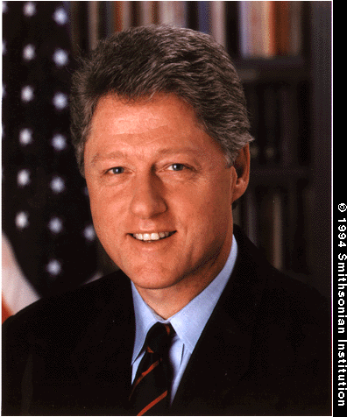
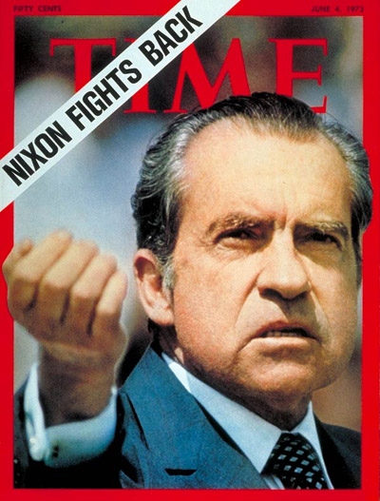
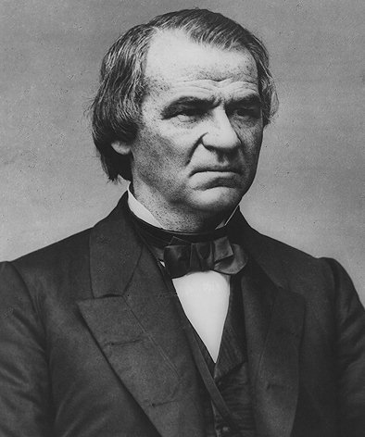
History of Presidential Impeachment
Only two Presidents have been impeached
  Andrew Johnson and Bill Clinton
  Neither convicted
  Both were considered “political”
  In neither case did “misbehavior” go to corruption in office
Nixon: Would have been impeached and convicted. Resigned days before vote.

Slide 78
Confirmation
Senate must confirm presidential appointments.
Referred to appropriate standing committee.
Committee holds hearing to determine whether to recommend confirmation.
If Committee votes to recommend, then Senate votes as a whole. Majority vote required.
Cabinet nominations are rarely rejected. Only 12 of 600 voted down.
Judicial nominees given closer scrutiny.
More often nominees withdraw if it appears that there will be serious opposition in the Senate
President typically appoints people who can be confirmed.
Senatorial Courtesy.

Slide 79
Ratification of Treaties
Treaties must be ratified by 2/3 of Senate
Senate may reject, ratify or add amendments and condition approval on the acceptance of amendments by the other parties to the treaty.

Slide 80
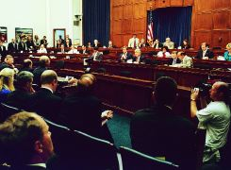
Investigatory Powers
Congress has broad powers to investigate any matter that falls within the scope of its legislative powers
Usually done through committees.
  Kennedy Assassination, Watergate, other scandals, matters of public policy, crime,

Slide 81
Investigatory Powers
Basic reasons for investigations include:
  gathering information
  oversee the operations of executive departments
  focus public attention of a particular subject
  expose the questionable activities of public officials
  promote the particular interests of some members of congress
Congress often holds investigations for political reasons—to show that are concerned about issues, to get themselves in from the cameras, etc.

Slide 82
Review
If the vice president becomes vacant, how is a successor chosen?
What public officer can a house member impeach?
Which two Presidents have been impeached?
Describe the outcomes of the trials.
Why did Clinton supporters want to censure him during his impeachment?
What did the house judiciary Committee seek in the subpoenas it severed on President Nixon?

